Slide 1
‘Being more creative with less’
North West Area.

Slide 2
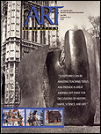
Challenge of Art Education
The past fifteen
years have seen a number of significant changes in the field of Art Education.
Art Education in Prison has had to change & adapt to many pressures placed upon its over the past 15 years. The creative nature of the subject has assisted departments to re-invent themselves. Responding to the many changes; cultural, political and financial.
NW Art Tutor 2013
The Challenge to Art Education
Elliot W. Eisner
Art Education. 1967

Slide 3
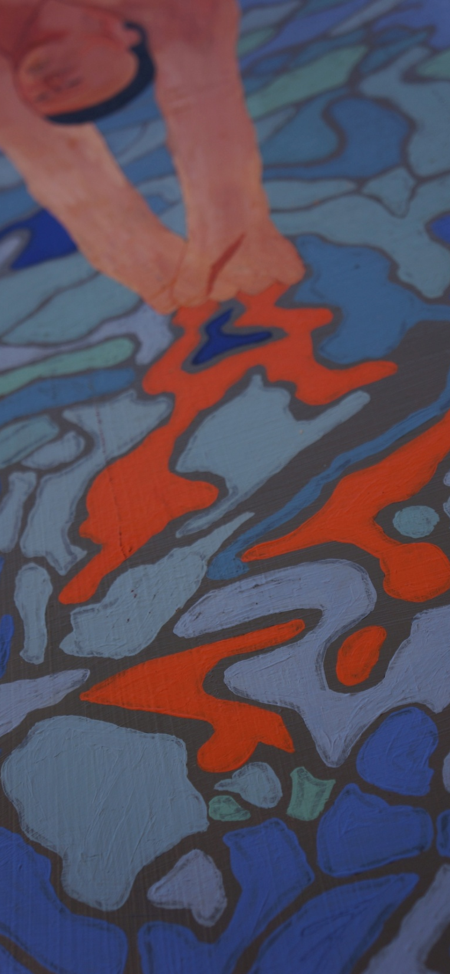
North West Area
Strong foundation of Arts
All prisons have an Art curriculum
Experienced many challenges
NW Co-op / Koestler Awards
Diversity across the area
Notes:
Sculpture, Painting & Drawing, Mixed media, Oil & Acrylics, Poetry, Written Word, Songwriting, Craft, Textiles, Radio, Digitaladvertising;
animation;
computer games;
facilities (which includes post production, studio and equipment hire, special physical effects, outside broadcast, processing laboratories, transmission, manufacture of AV equipment and other services for film and TV);
fashion and textiles;
film;
interactive media;
other content creation (pop promos, corporate and commercials production);
photo imaging;
publishing (books, journals, magazines, newspapers, directories and databases, news agencies, and electronic information services);
radio; and
advertising;
animation;
computer games;
facilities (which includes post production, studio and equipment hire, special physical effects, outside broadcast, processing laboratories, transmission, manufacture of AV equipment and other services for film and TV);
fashion and textiles;
film;
interactive media;
other content creation (pop promos, corporate and commercials production);
photo imaging;
publishing (books, journals, magazines, newspapers, directories and databases, news agencies, and electronic information services);
radio; and
television.

Slide 4
Strengths
Strong Arts network
Quality of provision. Ofsted
Engagement across area
Enrichment activities
Achievement

Slide 5
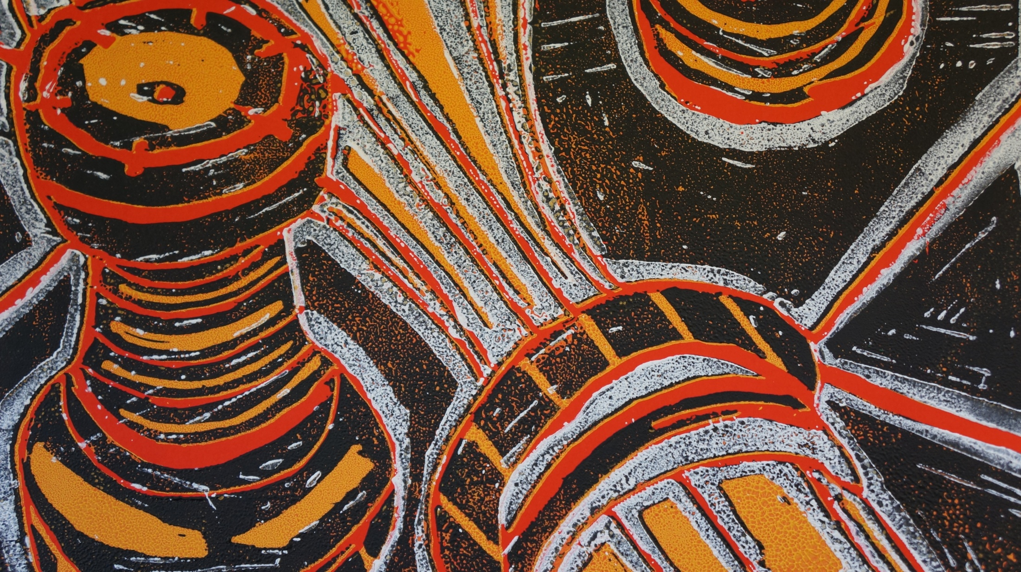
Qualification shift
Art qualifications
Arts Open Awards
City & Guilds
Link Functional Skills
Employment Outcomes
Personal Development
Problem Solving
Team Building
Employability:
35-40% of UK employers feel that their staff lack customer handling, team working and problem solving skills –
www.wigan.gov.uk LMI 2012

Slide 6
North West L&S Starts
Arts/Creative
Employability | 13945
SFL 2012/13 = 11077 VT = 14716
North West Total Starts 2012/13 = 60,456

Slide 7
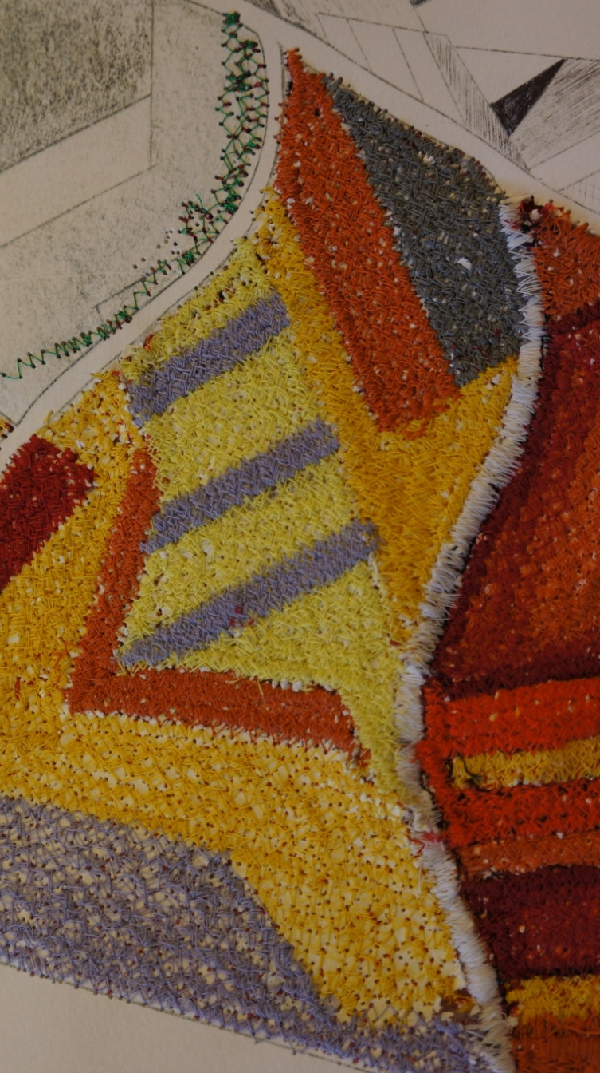
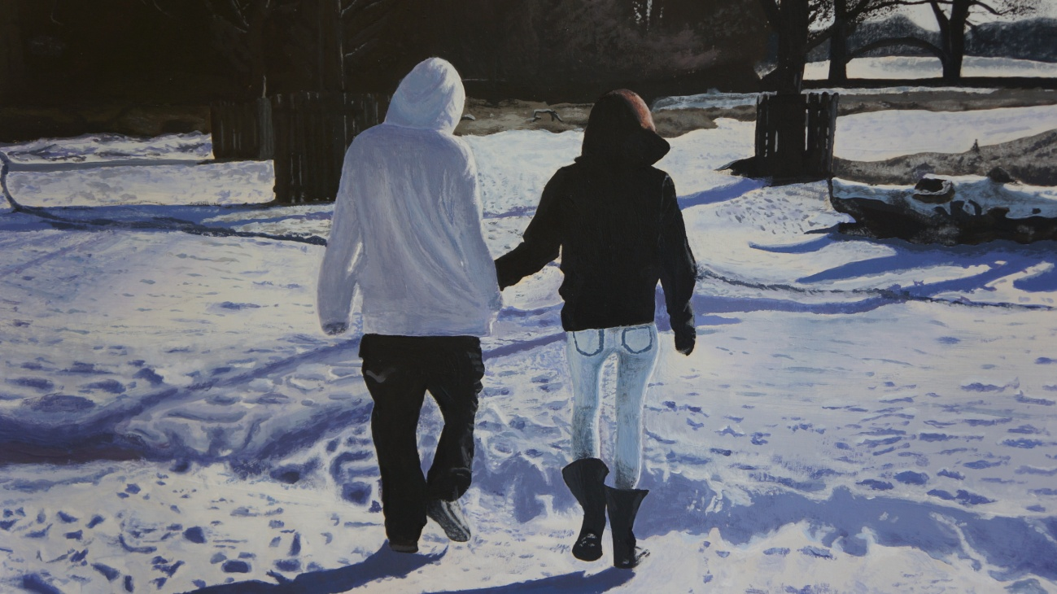
Quality of provision
Qualifications
Professionalised teachers
Greater external links
Variety of Certification
Increased Prison awareness

Slide 8
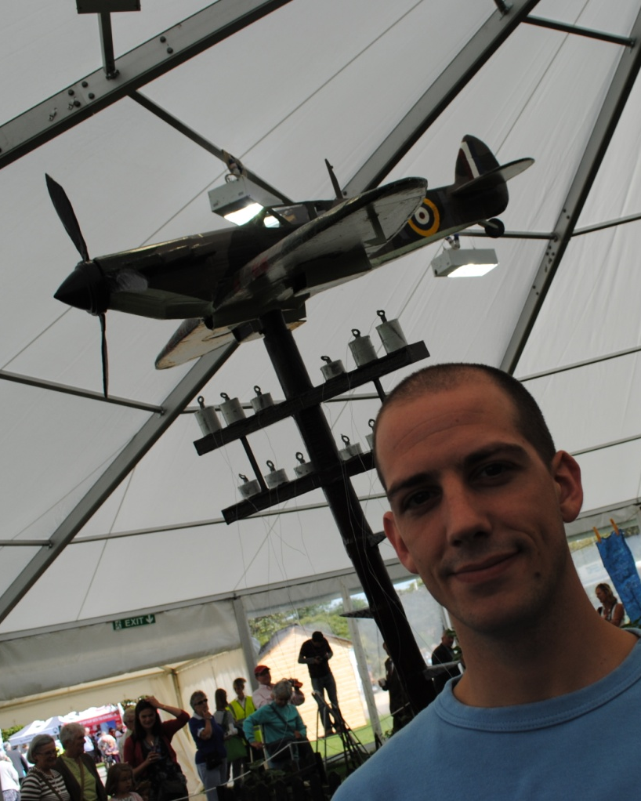
Art & Social Enterprise
Prison Engagement
Support Cultural Events
Health Promotion
Celebration Days
Host Prisoner Concerts
Charity Events
Tatton RHS Garden
Southport Flower Show
Harrogate International Festival
EPEA Conference

Slide 9
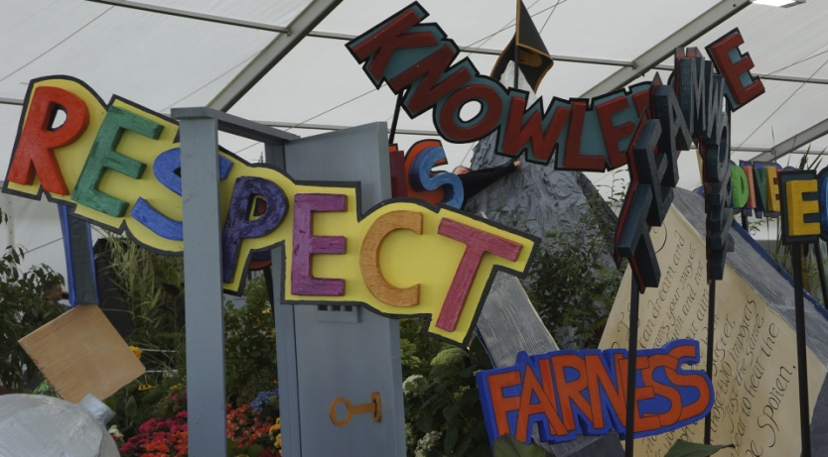
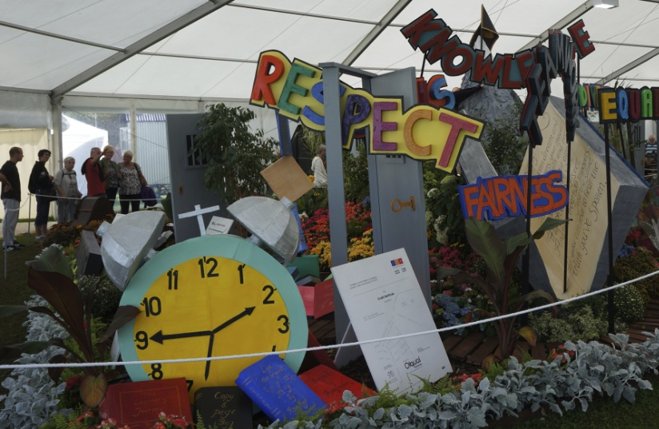
Southport 2013
Skills:
Ccommunication Skills.
Problem Solving.
Organisational Skills.
Valuing Diversity & Difference.

Slide 10
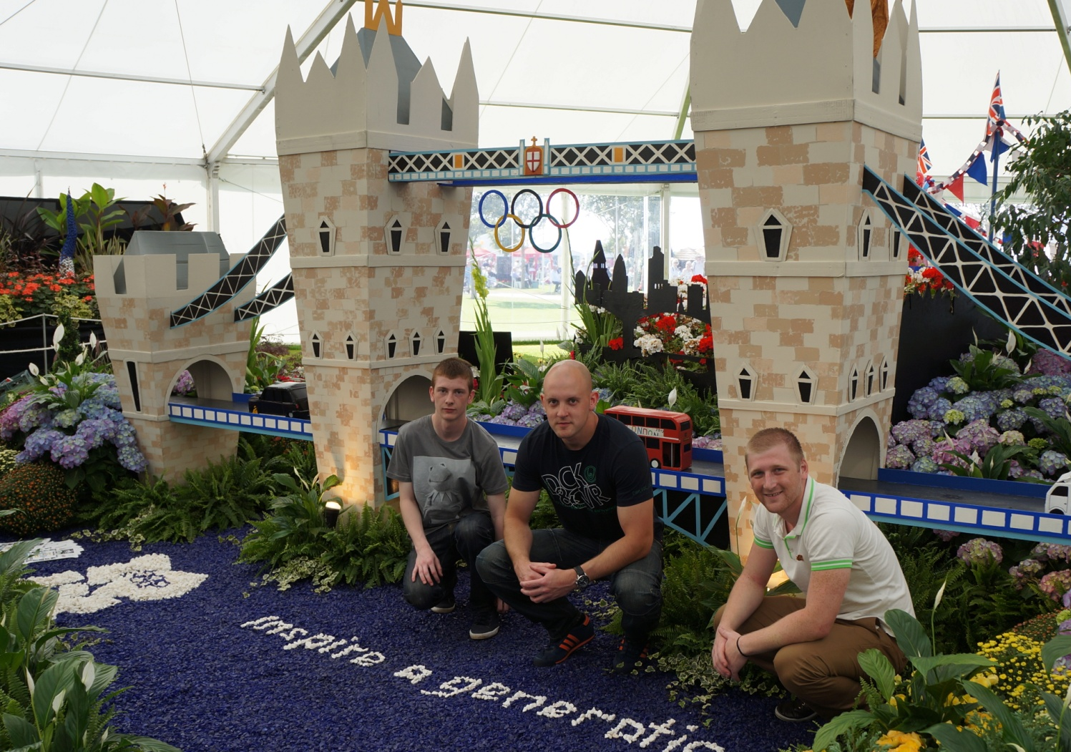
Southport Garden
Skills:
Team work. Project Design. Time Management. Communication Skills. Problem Solving
Work within Budget.

Slide 11
Successful Partnerships 2013
PSD budget spend
Halle Orchestra
Clean Break
Music in Prisons
TiPP
Tate Gallery.
Liverpool Art Gallery
Stockport Gallery
Writer in Residence
"Thank you so much for helping me believe in myself. I wish this didn't have to end."
Workshop participant, HMP Styal
Partners:
Skills & Knowledge. External Opportunities. Time Management. Self-Motivated.
Ability to Learn & Adapt. Prison Enrichment

Slide 12
Challenges of Creative & Digital
Creative and Media is one the UK’s major unique selling points , contributing more than £50 billion to the economy every year.
Sources: The Digital and New Media Industries
Simon. Buckley Hall

Slide 13
NW LMI. Creative & Digital
Media City. Salford
UK Enterprise Centre. Burnley
Advertising;
Animation;
Computer games;
Fashion and textiles;
Film;
Interactive media;
Photo imaging;
Publishing;
Radio;
Television.
7.6% Employment in NW
2,278,500 UK employed .
NW growth area
Sources: nomis/creative skills.org

Slide 14
Challenges
Teacher
Quality
Prison Staff
Olass PSD
Progression
OU students
Curriculum
TTG Links
LMI
Support & Develop (Isolated)
Shared CPD
Manage prisoners through Art
Regional Opportunities
Art development – ICT - FS
Links to develop
Specialist area development.
Progression to Community College
Employer Engagement

Slide 15
North West Area.

